Slide 1

Gender Tropes in Victor Herbert's Music

Slide 2
Gender Tropes in Media
Men are often portrayed as strong, tough, and self-sufficient
Women are often portrayed as elegant, weak, overly emotional, and dependent

Slide 3
Victor Herbert's Operettas
One of the things that Victor Herbert was known for were his operettas, or light operas.
Instrumental selections from his operettas were often used for silent film.
Since many of the examples of these tropes are found in the instrumental parts, these tropes would transfer to silent films as well.

Slide 4
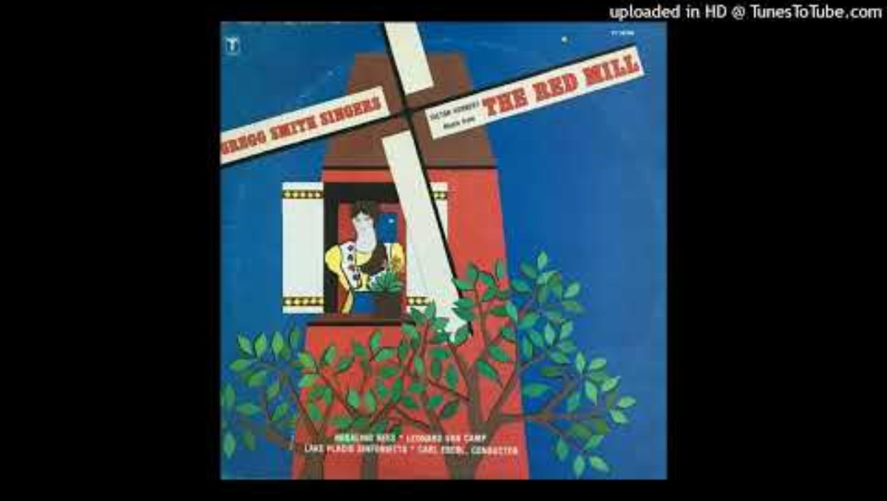
"A Widow Has Ways" from The Red Mill
The vocal melody and the instrumental part are both very elegant, enforcing the trope that women are always elegant.
The song also has a light and delicate feel, which mirrors the trope of delicate women.
Finally, the accompaniment often plays the melody with the singer, highlighting the trope that women are dependent.
Channel: Bruce Greengart; performed by the Gregg Smith Singers and Lake Placid Sinfonietta; Kimball Wheeler, mezzo-soprano; Carl Eberl, conductor

Slide 5
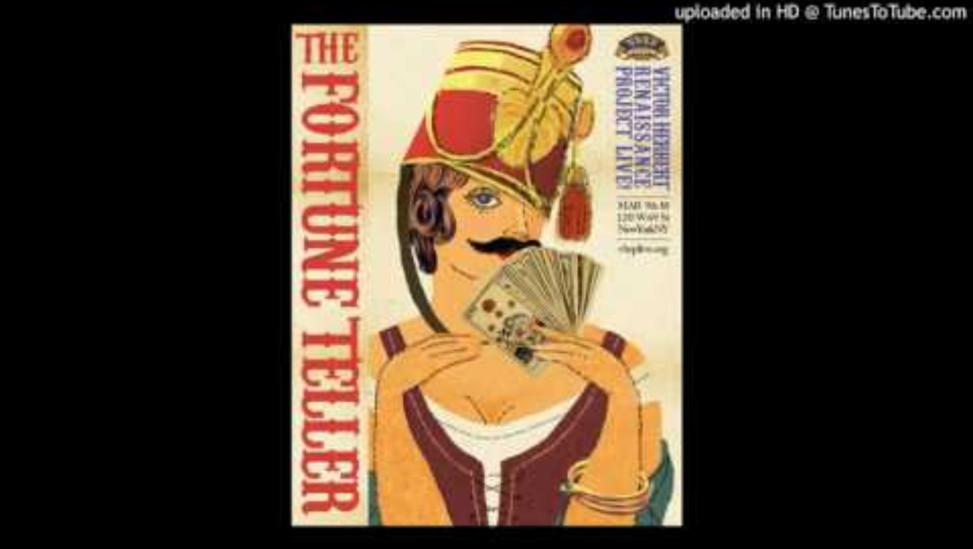
"Ho! Ye Townsmen" from The Fortune Teller
This song has a sparse instrumental texture, which reinforces the trope of self-sufficient men.
In the instrumental part that is there, the sound is often very full, which reinforces the trope that men are tough and strong.
Channel: VHRP Live! Performance by VHRP Live!

Slide 6
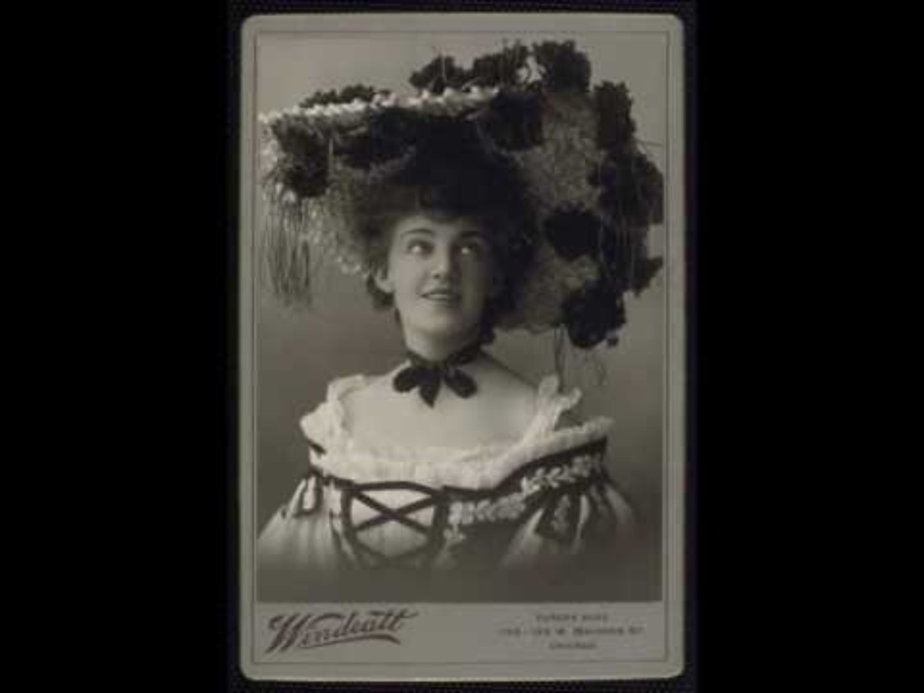
"Barney O'Flynn" from Babes in Toyland
The melody of this song is very elegant, again reinforcing the trope of the always elegant woman.
The instrumentation and lack of fulness in the orchestra sound reinforce the stereotype of the delicate woman.
Channel: SirParsifal; Performed by London Voices and London Sinfonietta; Elizabeth Furtral, soprano; John McGlinn, conductor

Slide 7
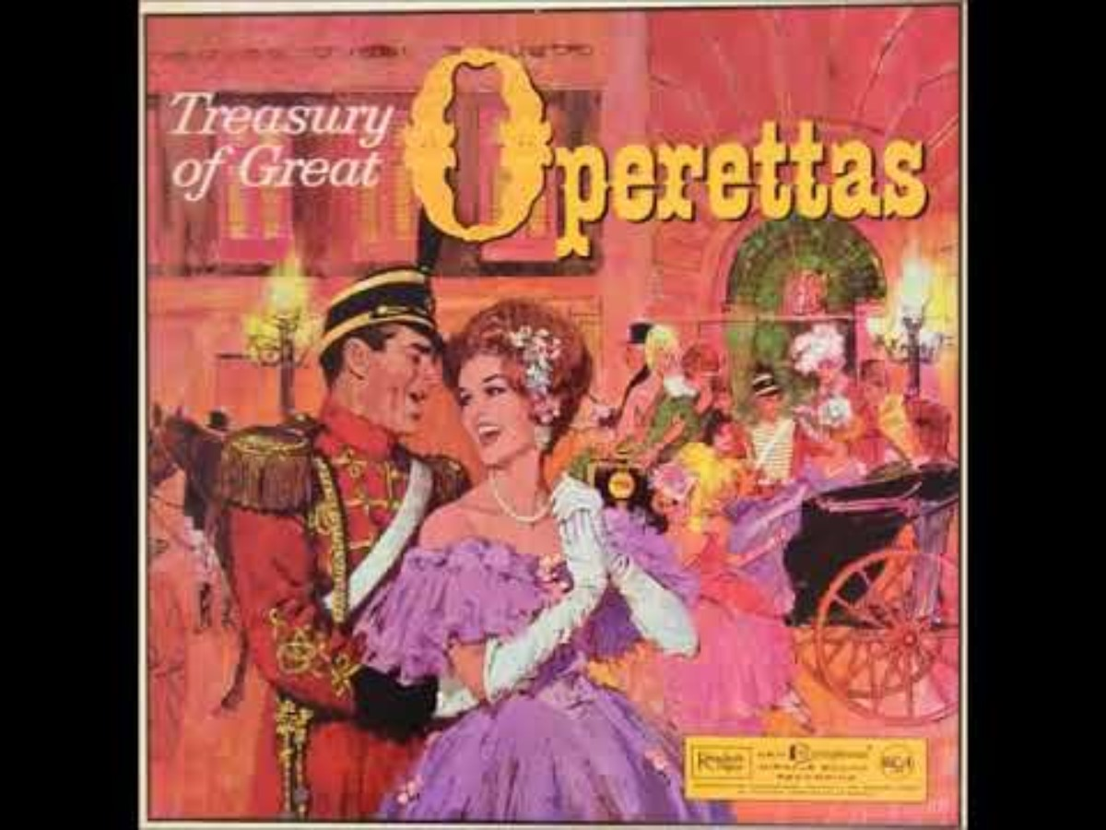
"The Time, the Place, and the Girl" from Mlle. Modiste
This song opens in a march style, reinforcing the trope of the tough, strong man.
The music in the waltz section is much more tender and elegant, seeming to break away from the typical male tropes. However, this song is referring to a woman, so this section is meant to evoke some of the typical female tropes.
Channel: BlondieJohnson; Performed by Arthur Rubin; Lehman Engel, conductor

Slide 8
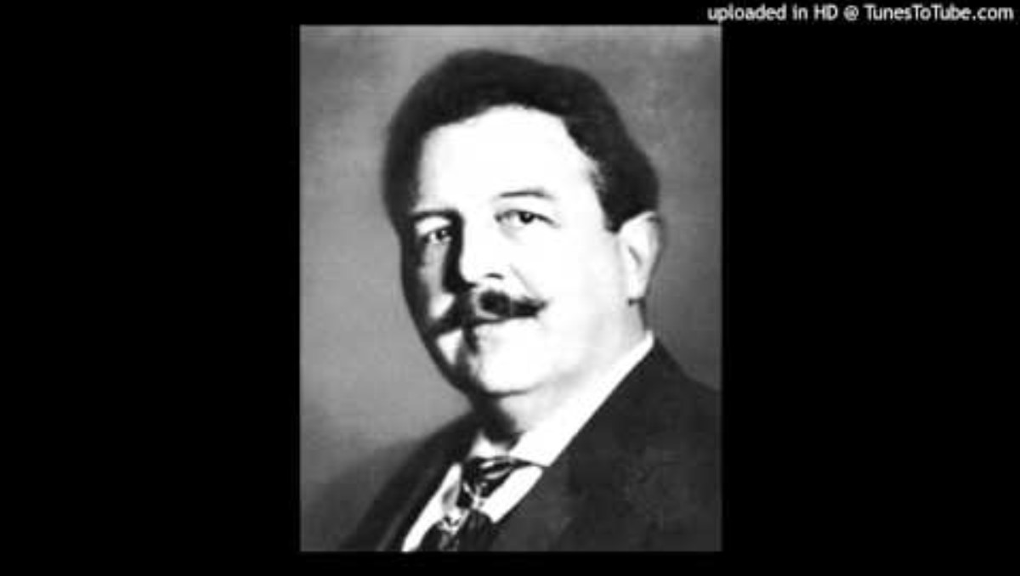
"Naughty Marietta" from Naughty Marietta
Even this song, in which a woman is describing not behaving as expected, is mostly light, delicate, and elegant.
There are three notable exceptions: on the words "torrid," "bad," "horrid." These words do not fit the stereotypical model woman, so the orchestral parts here do not fit the stereotype either. Brass instruments are used in these spots and harmonies do not sound as nice.
Channel: Bruce Greengart; Performed by the New York City Opera; Gianna Rolandi, soprano; John Mauceri, conductor

Slide 9

"If I Were Anybody Else But Me" from Naughty Marietta
The contrast between the music for male and female characters can clearly be heard in this duet.
While the male character is more conversational at the beginning, the female character is lyrical and elegant.
In the stronger section, the orchestral part while the male character is singing is much stronger and bolder. The orchestral part while the female character sings is lighter and more elegant.
Channel: Bruce Greengart; Russ Thacker; Gianna Rolandi, soprano; John Mauceri, conductor

Slide 10
References
Evolution of Female Characters in Popular Culture – ShoutOut! James Madison University
Stereotypical Women's Representation in the Film Industry
Common Stereotypes of Men in Media | MediaSmarts

