Slide 1
Victor Herbert Six Piano Pieces
Created by Camren Davis

Slide 2
Brief Intro to Herbert
Born in 1859
Co-founder of the American Society of Composers, Authors and Publishers
- served as VP and Director until his death
Started playing piano at the age of 17
Became dedicated to the cello around 19
Composed numerous piano pieces in his career

Slide 3
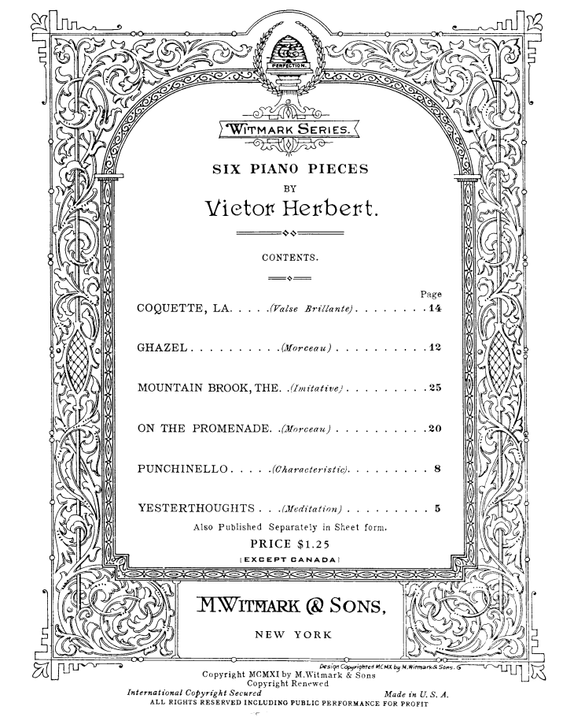
About the Six Pieces
Published by Witmark and Sons in New York, 1919
- Leading publisher of sheet music in the U.S "Tin Pan Alley" music industry
- "Tin Pan Alley": Collection of music publishers and songwriters that dominated the music scene during the 19th and 20th century
All pieces performed solely by Herbert

Slide 4
Ghazel (pg.1)
Scan these for audio recording of the song

Slide 5
(Pg.2)

Slide 6
La Coquette (pg.1)

Slide 7
2

Slide 8
3

Slide 9
4

Slide 10
5

Slide 11
6

Slide 12
The Mountain Brook (pg.1)

Slide 13
2

Slide 14
3

Slide 15
4

Slide 16
5

Slide 17
On the Promenade (pg.1)

Slide 18
2

Slide 19
3

Slide 20
4

Slide 21
5

Slide 22
Punchinello (Pg.1)

Slide 23
2

Slide 24
3

Slide 25
4

Slide 26
Yesterthoughts (Pg.1)

Slide 27
2

Slide 28
3

Slide 29
Credits
IMSLP Music Public Library
- https://imslp.org/wiki/6_Piano_Pieces_(Herbert%2C_Victor)
- https://imslp.org/wiki/M._Witmark_%26_Sons
Audio recordings performed by William Hicks
https://open.spotify.com/artist/53jLgwKMIJ4mk4oKx8aizK?si=QNPtA6QCSr-lDL1Jofy9dQ
Album Link:
- https://open.spotify.com/album/1DNnN0t70TZTuCc53nmFrs?si=UWP34hboSaaq7Nd32DC5Sw

