Slide 1
The Short Story Behind “Kiss Me Again,” One of Victor Herbert’s Most Popular Tunes

Slide 2
Setting The Stage
2
One of Victor Herbert’s biggest claims to fame were his many operettas. In 1903 he employed a famous soprano, Fritzi Scheff, to star in his new operetta Babette. During one showing, Scheff pulled Herbert on stage during the curtain call and gave him a showy kiss on the cheek.

Slide 3
“Fritzi Scheff as Babette: A New Comic Opera by Herbert and Smith: The ex-Grand Opera Singer Makes a Brilliant Success,” New York Times, November 17, 1903
“Fritzi Scheff, having abandoned her claim to being a "grand opera" singer, for a time at least, appeared last evening at the Broadway Theatre as the chief personage in a romantic comic opera by Victor Herbert and Harry B. Smith. It was an occasion that rejoiced those who have admired the qualities of this grand operatic soubrette, and who have felt that she was out of place in many of the casts in which she has been appearing in the establishment a block further down town. [….]
“At the end of the second act she responded with a pretty little flutter of embarrassment to the evident desire of the audience to hear from her, and thanked them ever so much for their kindness, and hoped they would always come to hear her as they used to at the Metropolitan Opera House. Then she looked around for Mr. Herbert and dragged him forth; and having shaken him heartily by the hand, she then and there threw her arms around his neck and gave him a kiss that was clearly the real thing and not the kind used on the stage. Mr. Herbert then tried to express his thanks also; but if he had made any calculations they were all upset by this unexpected incident. Finding his last sentence hopelessly involved he stopped it short and added: "Well, she twisted me all up by kissing me!"

Slide 4
Another Source
According to one account, this kiss proved to be quite the scandal, and it left audience members and musicians alike to speculate on Herbert and Scheff’s ongoing relationship. Here, an unnamed narrator tells the story and plays a recording of Sheff singing “Kiss Me Again” in her old age. (Curzon Road, https://www.youtube.com/watch?v=YcdrTBAyrQg)

Slide 5
A portrait of Fritzi Scheff circa 1910

Slide 6
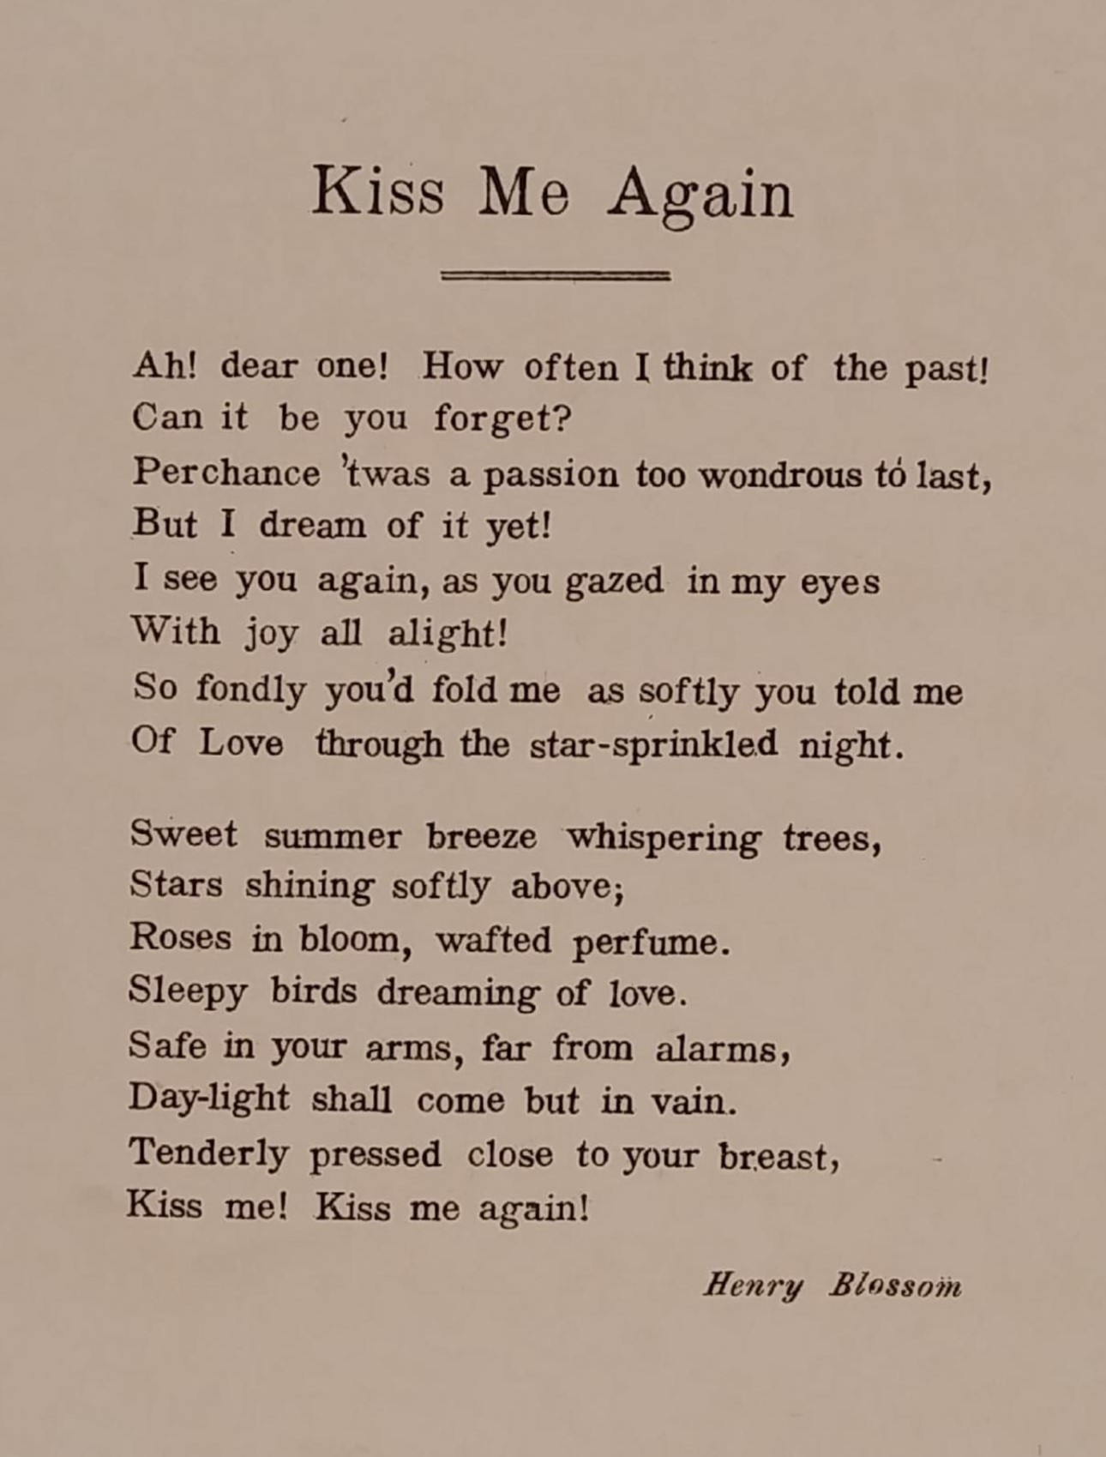
Mlle. Modiste
6
In 1905, Herbert wrote his new comic opera, Mlle. Modiste, once again starring Fritzi Scheff as the lead. The story follows a young girl named Fifi who works in a hat shop but has dreams of being an opera singer.
Fifi’s most popular solo within, “Kiss me Again,” takes a theme from another piece in the operetta called “If I Were On Stage,” this time set to romantic, love-filled lyrics. Although the lyrics of the song are fitting for the story, it seems clear that the title is in reference to Sheff’s famous kiss two years earlier.
“Kiss Me Again” Lyrics, written by Henry Blossom

Slide 7
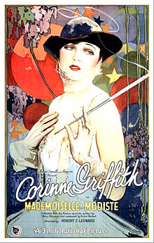
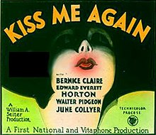
The Impact of “Kiss Me Again”
After “Kiss Me Again” became Scheff’s signature piece, its popularity skyrocketed. Alongside many appearances as a theme played live for use alongside “silent” films, it has seen countless recordings from many different ensembles. Additionally, its source material – Mlle. Modiste – was remade into two feature length films: The silent film “Mademoiselle Modiste” in 1926, and the “fully in technicolor” film “Kiss Me Again” in 1931 respectively. Posters for both can be seen beside.

