Slide 1
Babes in Toyland
Victor Herbert's Most Famous Operetta

Slide 2
The Operetta
Babes in Toyland is an operetta first produced in 1903, composed by Victor Herbert, with a Libretto by lyricist Glen MacDonough. It adapts characters from the classic Mother Goose nursery rhymes into a fantastical story spanning three acts. It debuted at Chicago’s Grand Opera House in June of 1903 and premiered on Broadway in October of the same year. It closed its Broadway run in March of 1904, after 192 performances. The operetta is one of Herbert’s most famous works. Several of its songs, particularly the piece “March of the Toys,” have gone on to enjoy even wider fame.

Slide 3
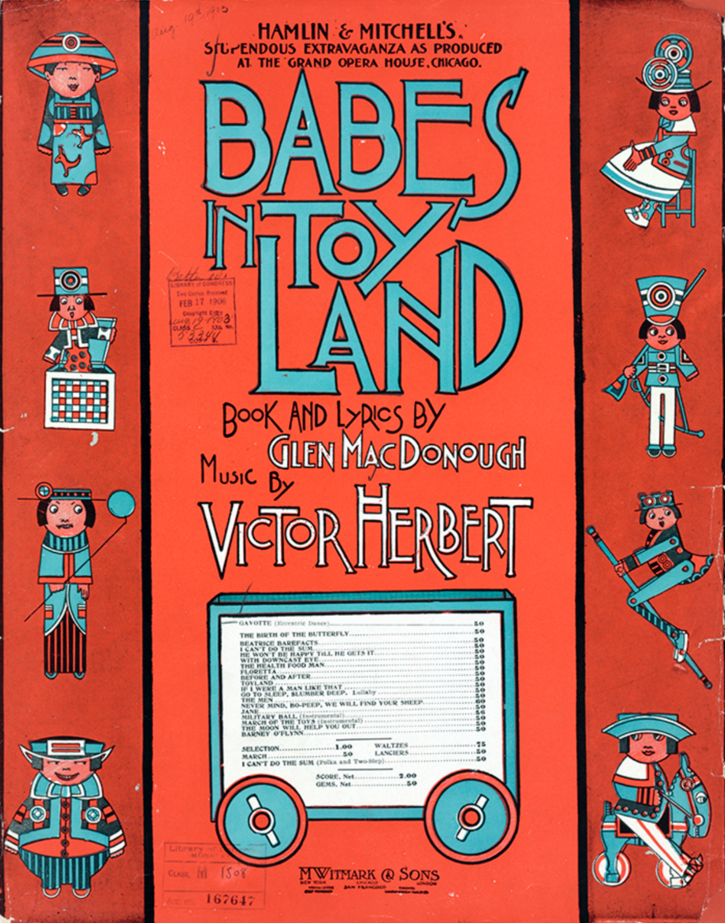
Victor Herbert. Babes in Toyland. Sheet music cover. New York: Witmark, 1903. Victor Herbert Collection, Music Division, Library of Congress (34.00.00)//www.loc.gov/exhibits/musical-worlds-of-victor-herbert/exhibition-items/Assets/vh0034_enlarge.jpg
The sheet music cover for the original book of Herbert’s Babes in Toyland (1903)

Slide 4
March of the Toys
“March of the Toys,” a piece from the second act of Babes in Toyland, is one of the most famous and recognizable excerpts from the operetta. It has appeared frequently in other media and is often played on its own as an orchestral work. In some adaptations of Babes in Toyland where very little of the original story or music is preserved, like the 1934 Laurel and Hardy film adaptation, “March of the Toys” still appears.

Slide 5
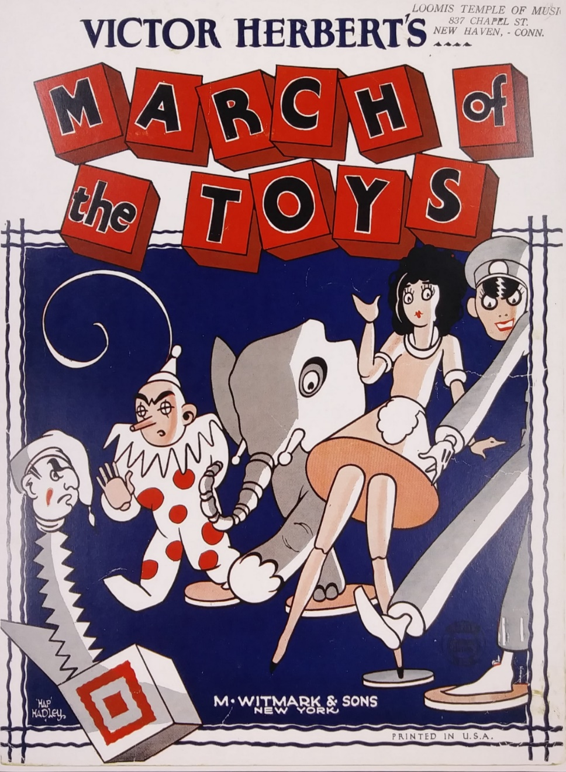
The cover for Victor Herbert’s piano score for “March of the Toys” (1903).
Victor Herbert, “March of the Toys” ( M. Witmark & Sons, 1903)

Slide 6
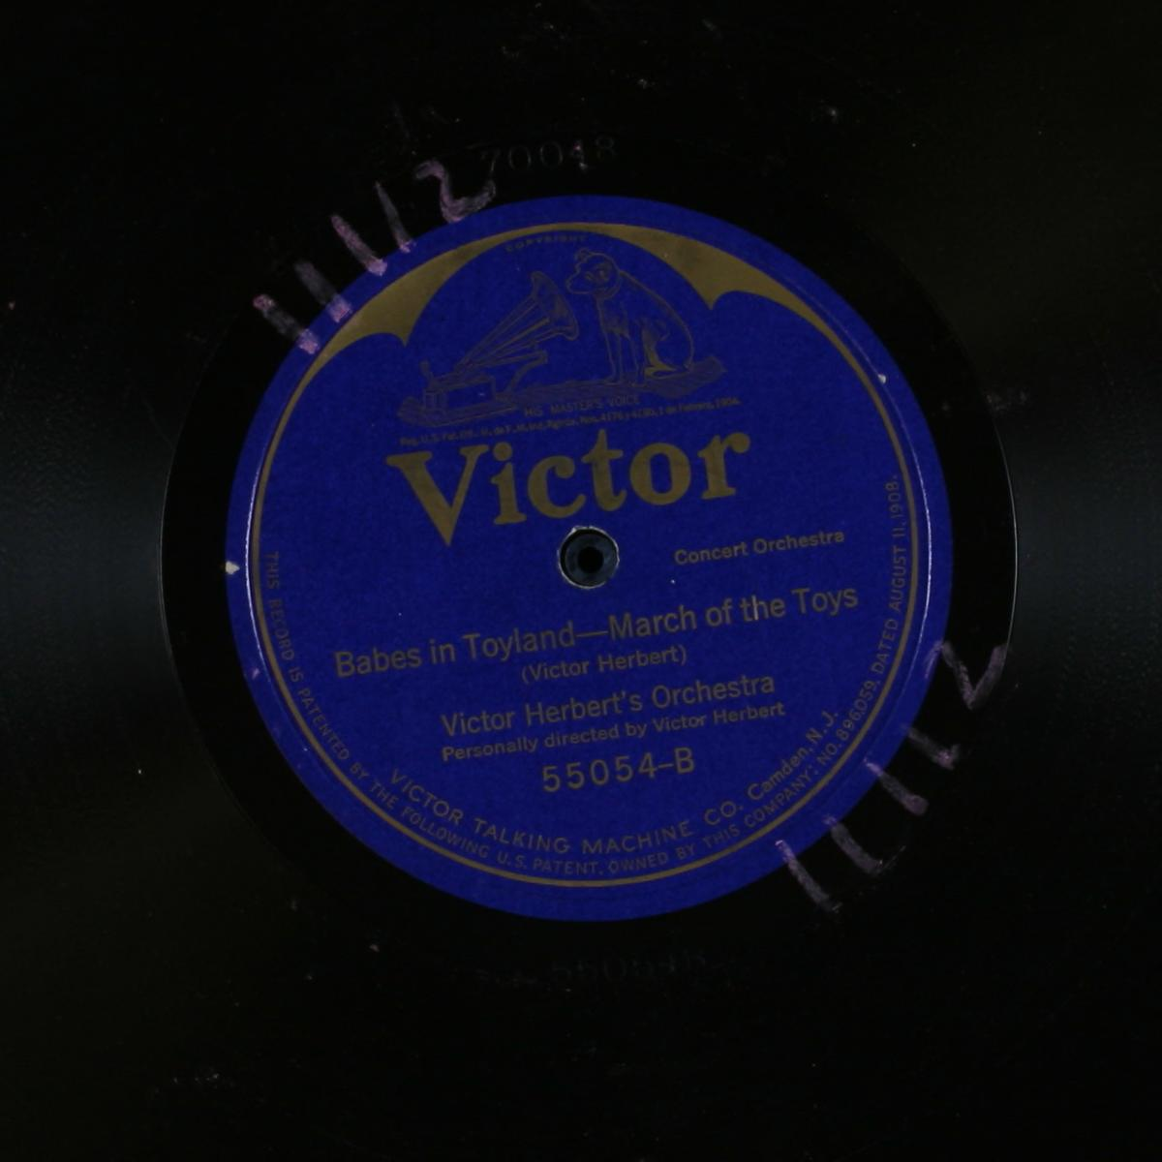
Herbert, Victor, Victor Herbert'S Orchestra, and Victor Herbert. March of the Toys. 1911. Audio. https://www.loc.gov/item/jukebox-130499/.
A recording of “March of the Toys” from Babes in Toyland, performed by Victor Herbert’s Orchestra and conducted by Victor Herbert (1903)
https://www.loc.gov/item/jukebox-130499/?

Slide 7
Use in Silent Film
Victor Herbert’s music was influential during the era of silent film. His works often appeared on “cue sheets” used by performers to accompany a film. The music from the famous Babes in Toyland is no exception.

Slide 8
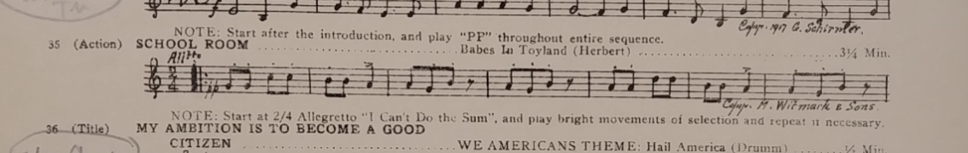
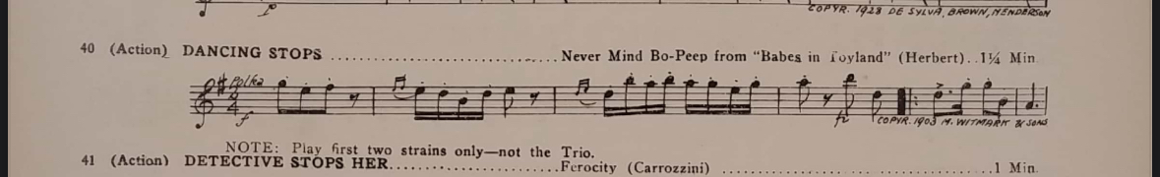
Sections from cue sheets for We Americans and Naughty Baby, by James C. Bradford (1928). Both make use of pieces from Victor Herbert’s Babes in Toyland. We Americans includes “School Room,” and Naughty Baby includes “Never Mind Bo Peep.”
James C. Bradford, “We Americans” (Thematic Music Cue Sheet, 1928)
James C. Bradford, “Naughty Baby” (Thematic Music Cue Sheet, 1928)

