Slide 1
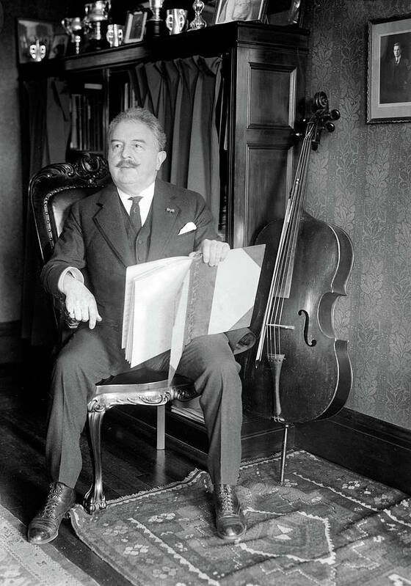
Victor Herbert
The Maestro Behind Silent Film's Musical Magic

Slide 2
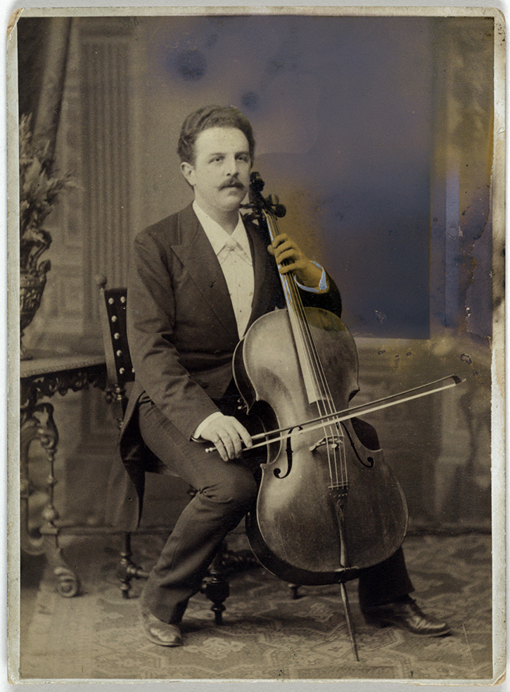
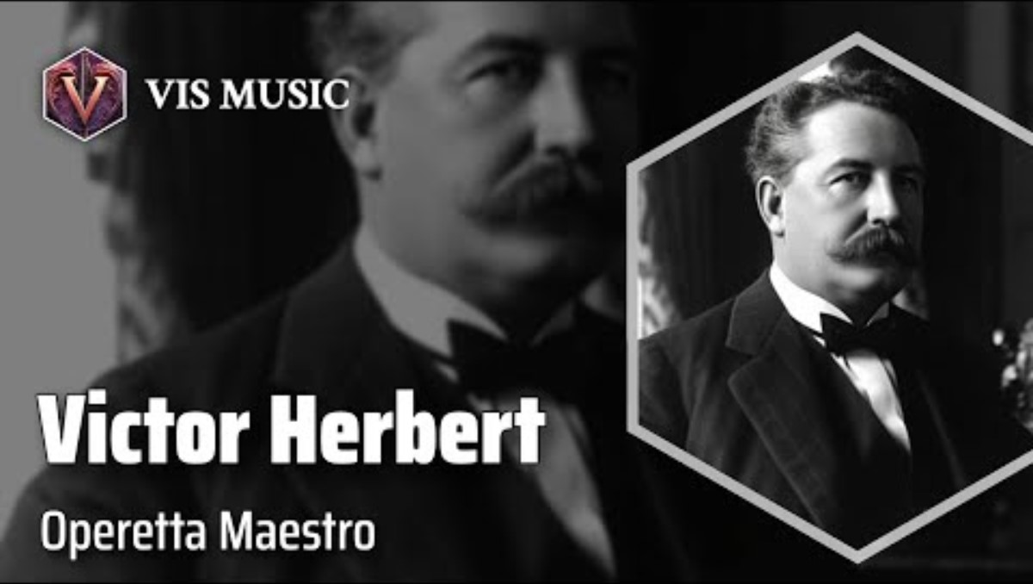
Early Life and Career
1859 Born in Guernsey
1888 Moved to the United States
1894 Began writing operettas

Slide 3
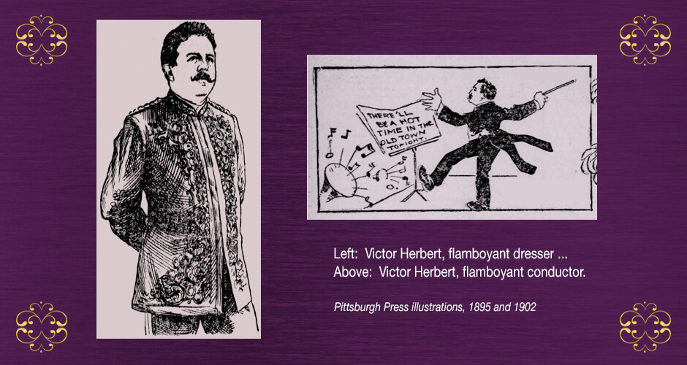
composer and conductor.

Slide 4

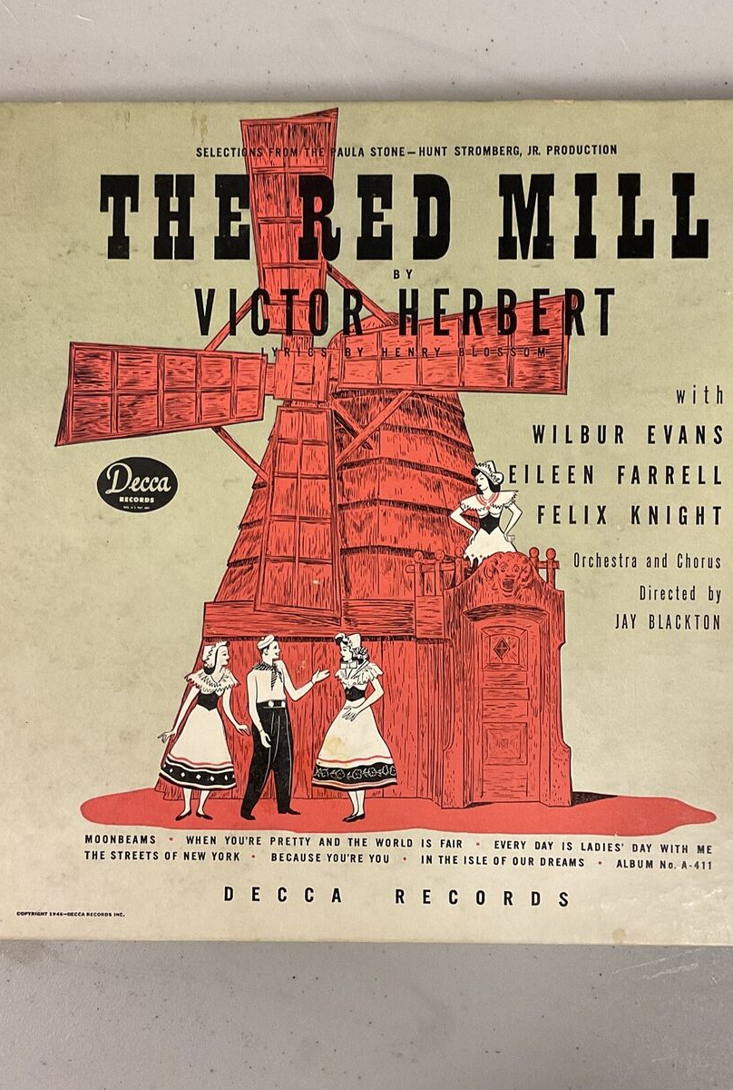
Some of Herbert's Film Music
Herbert’s involvement in silent film music:
The Red Mill (1927)
Janice Meredith (1924)

Slide 5
Herbert's influence in Silent Films
How Herbert's compositions helped convey emotion and enhance storytelling without dialogue
The Red Mill (1927), where Herbert’s music played a key role.
How Herbert’s music was synced with specific scenes from these film, for example the overture to Janice Meredith.

Slide 6
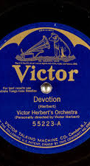
Influence on Later Film Music
Herbert’s musical techniques influence modern composers, particularly Joe Hisaishi, who scored Nausicaä of the Valley of the Wind (1984)
Musical similarities between Herbert and Hisaishi.
For instance, both composers used sweeping orchestral scores to create a sense of grandeur and emotion.
  Orchestration (large orchestra)
  Mood setting (evoking specific emotions)
  Thematic development (leitmotifs)

Slide 7
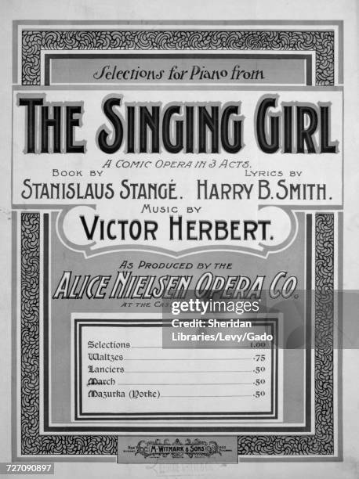
Integrating music and film
His method of pairing music with visuals is still used in modern cinema, including animated films like Nausicaä of the Valley of the Wind.
Herbert’s music was paired with specific scenes from his silent films.

Slide 8
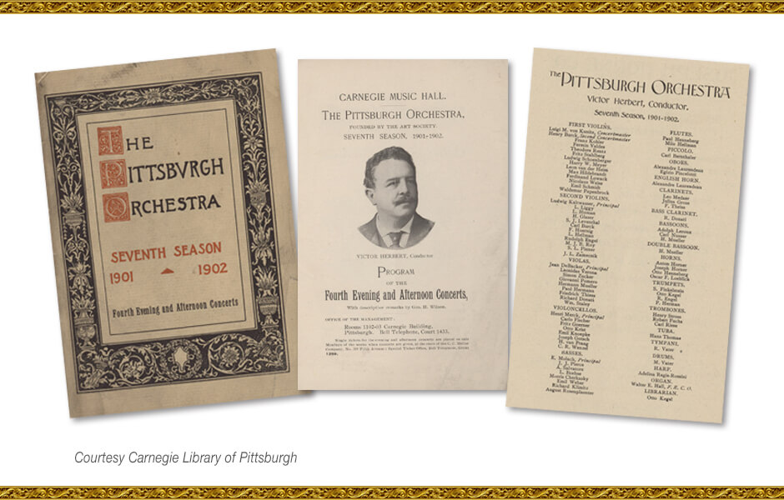
Legacy and Impact
Herbert’s pioneering work in silent film music influenced future film composers, especially in terms of musical storytelling.
His music is still used in modern orchestral film scores.

Slide 9
Thank you
Diego Montes

